Slide 1
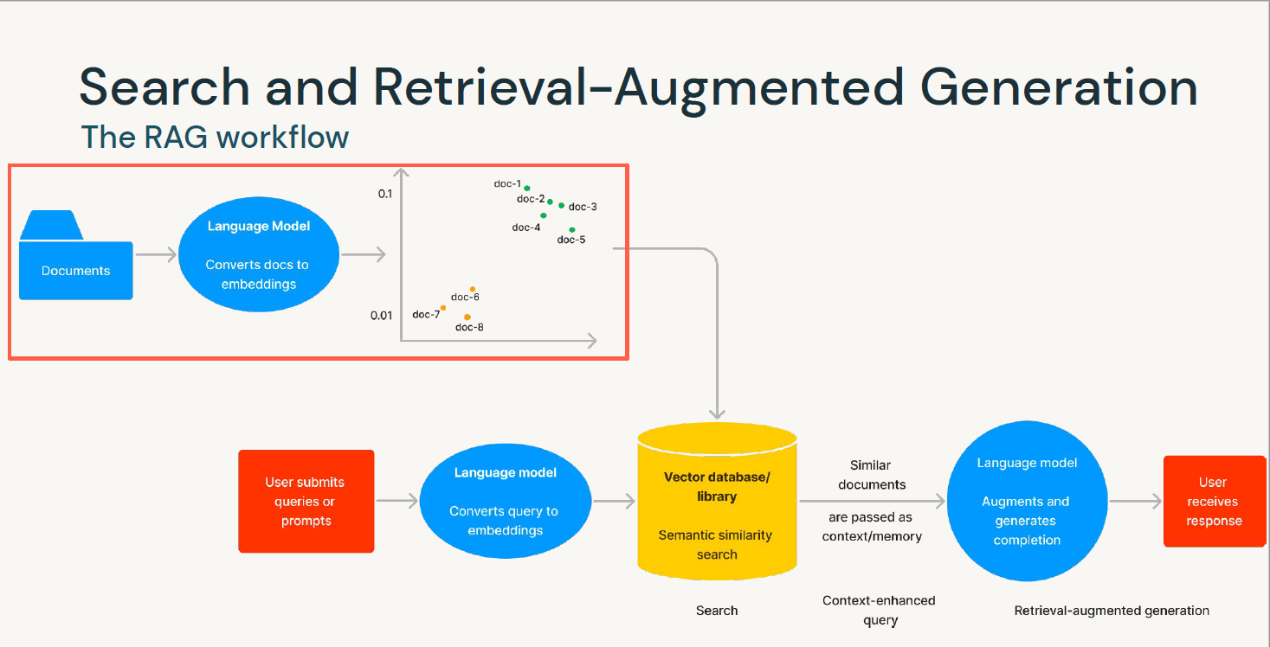

Slide 2
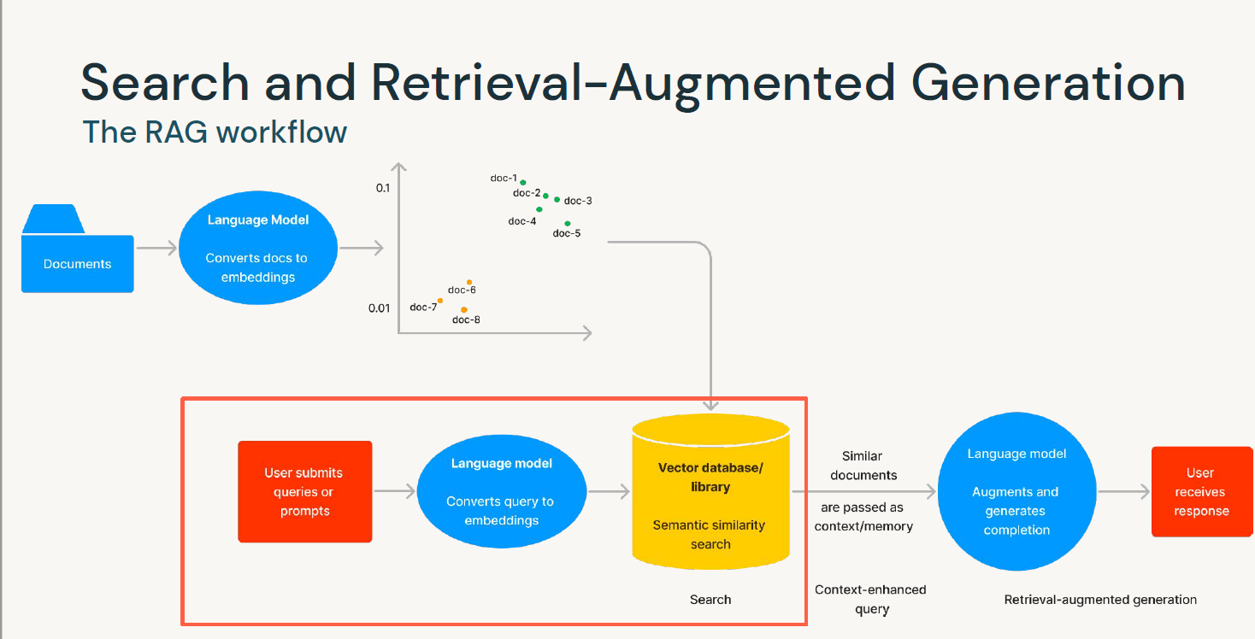

Slide 3
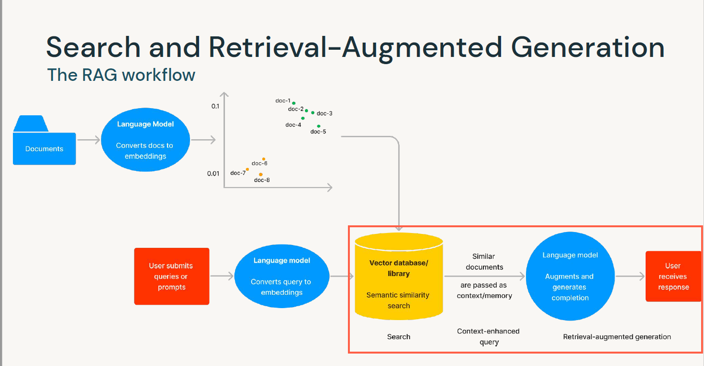

Slide 4
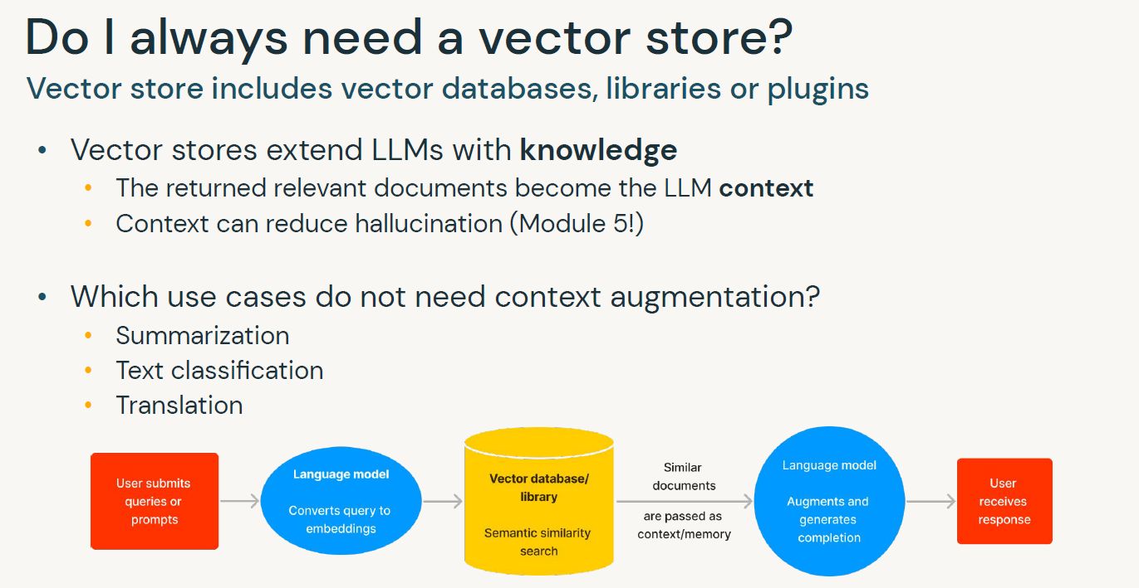

Slide 5
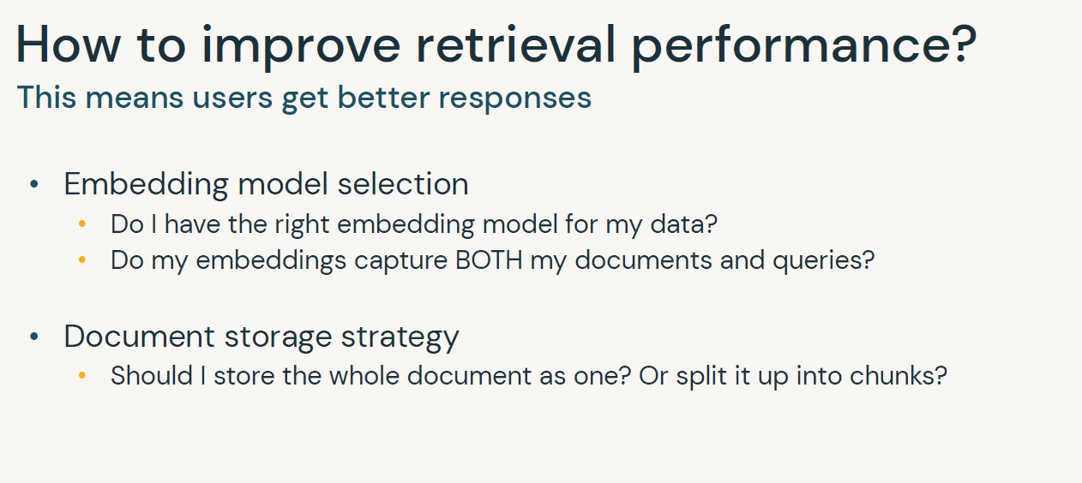

Slide 6
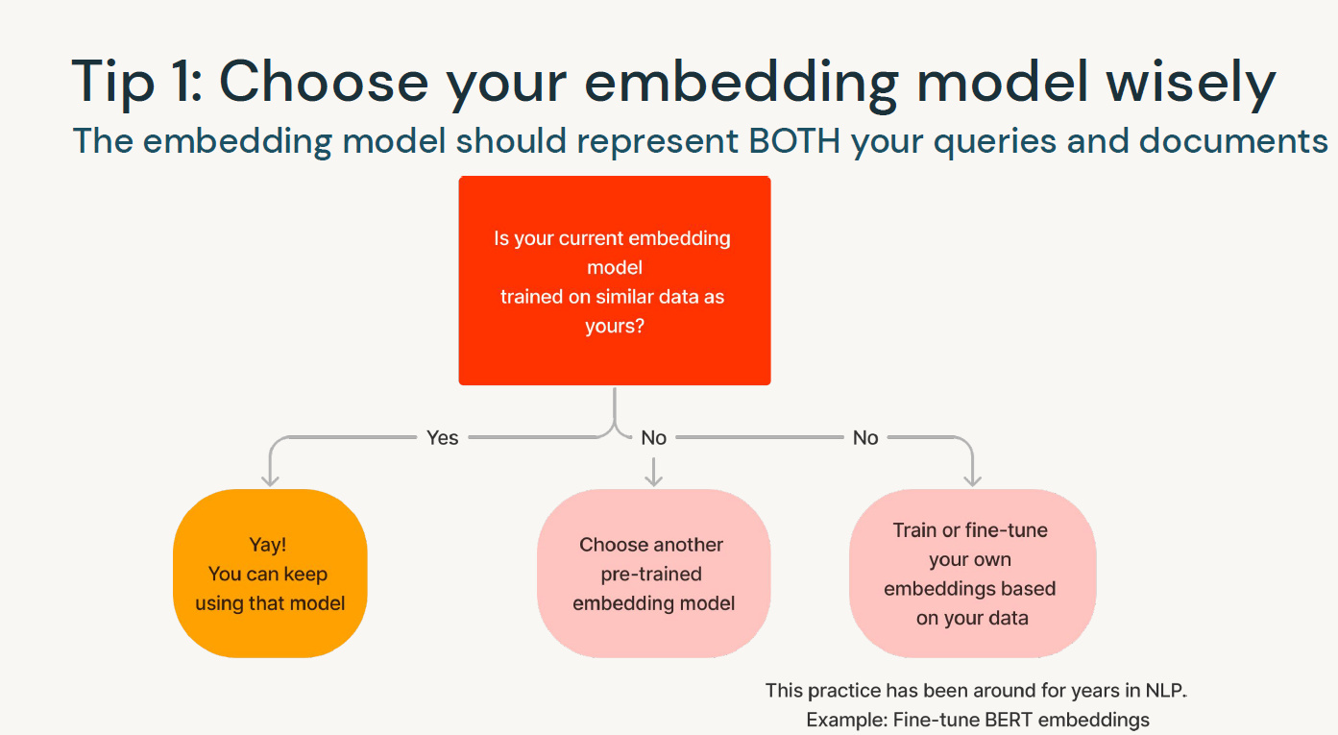

Slide 7
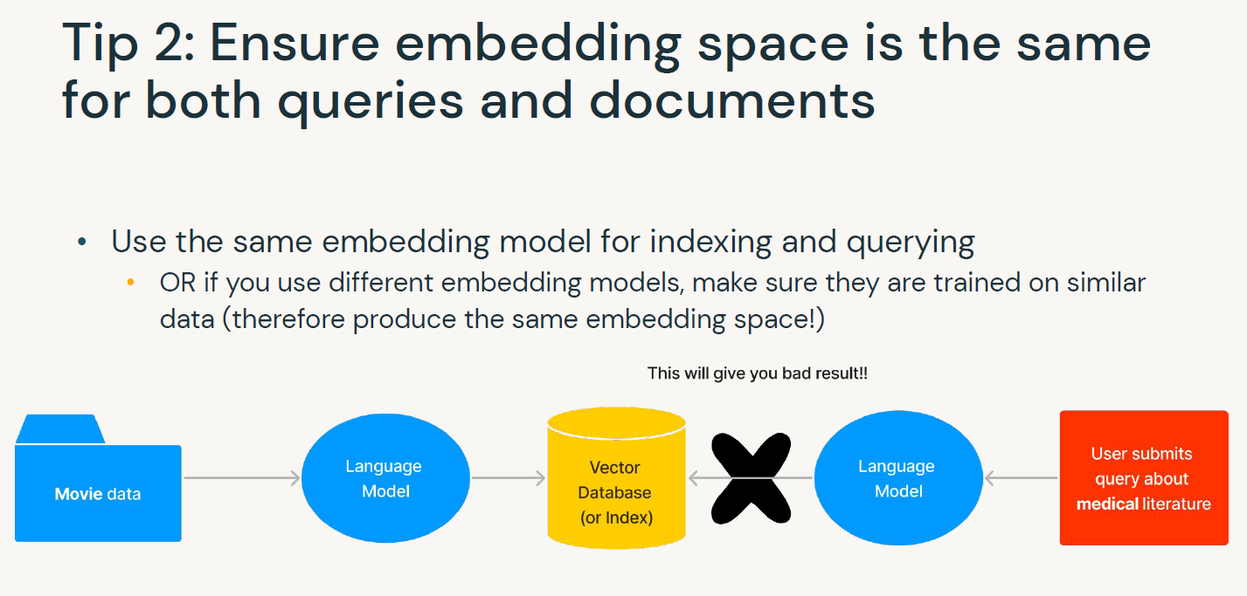

Slide 8
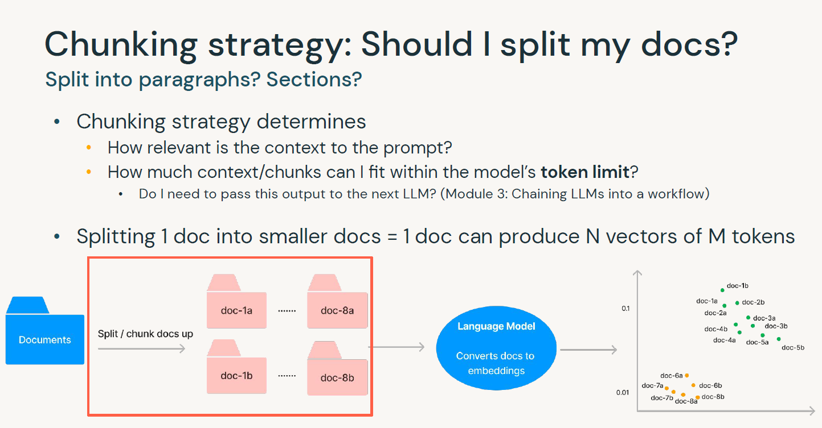

Slide 9
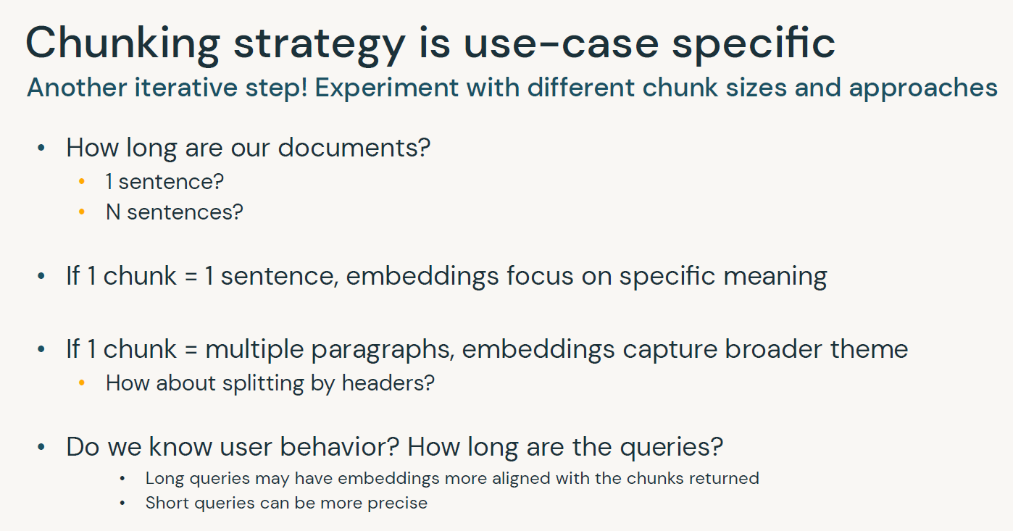

Slide 10
It’s still a very new field!
Existing resources:
• Text Splitters by LangChain
• Blog post on semantic search by Vespa - light mention of chunking
• Chunking Strategies by Pinecone
Chunking best practices are not yet well-defined

Slide 11
Preventing silent failures and undesired
performance
• For users: include explicit instructions in prompts
• "Tell me the top 3 hikes in California. If you do not know the answer, do not
make it up. Say 'I don’t have information for that.'"
• Helpful when upstream embedding model selection is incorrect
• For software engineers
• Add failover logic
• If distance-x exceeds threshold y, show canned response, rather than showing nothing
• Add basic toxicity classification model on top
• Prevent users from submitting offensive inputs
• Discard offensive content to avoid training or saving to VDB
• Configure VDB to time out if a query takes too long to return a response

